Slide 1
Front End Engineering-I Project
Team Details: (PG-10)
Samarth Kapoor:2310992202
Saksham Grover: 2310992200
Saksham Singh:2310992201
Faculty Coordinator: Dr. Shanky Goyal
:
Chitkara University Institute of Engineering and Technology,
Chitkara University, Punjab

Slide 2
Table of Contents
Introduction
Problem Statement
Technical Details
Key Features
Project Highlights
Bonus Feature
Conclusion
References/Links used

Slide 3
Introduction
EXPENSE TRACKER: EXPENSO
Developers:
Samarth Kapoor
Saksham Grover
Saksham Singh
Purpose and Goals:
An expense tracker is a financial tool that helps you keep track of your expenses. The main purpose of an expense tracker is to identify where you are spending your money, and from there, you can identify ways or opportunities to save or invest more of your money and reduce your cost of living.
Our goal is to organize people’s financial lives . And to help them keep a track of their
Savings and expenditure.

Slide 4
Problem Statement
To develop an app that helps to keep a track of the expenses and to helps maintain their budget and help in saving the the money for future aid.

Slide 5
Technical Details
VISUAL STUDIO CODE:
All the code is written and debugged on visual studio code.
HTML:
Html is used to make the structure of our website. Hyperlinks and all other text is presented by the use of html.
CSS:
The designing and styling of the website is done by css. Animation are also the part of css.
JAVA:
The calculations and data selection will be done through
java(soon)

Slide 6
Key Features
Keep a track of spending money:
It immensely help in tracking the expenditure done during the day, week, month or an year.
Set budgets:
It provides people the ability set budgets for themselves and help them from not going through financial crisis.
Analyze the expenses:
It helps in analyzing the expenses and find solution for saving the money and reduce the hassle at the end of the day.

Slide 7
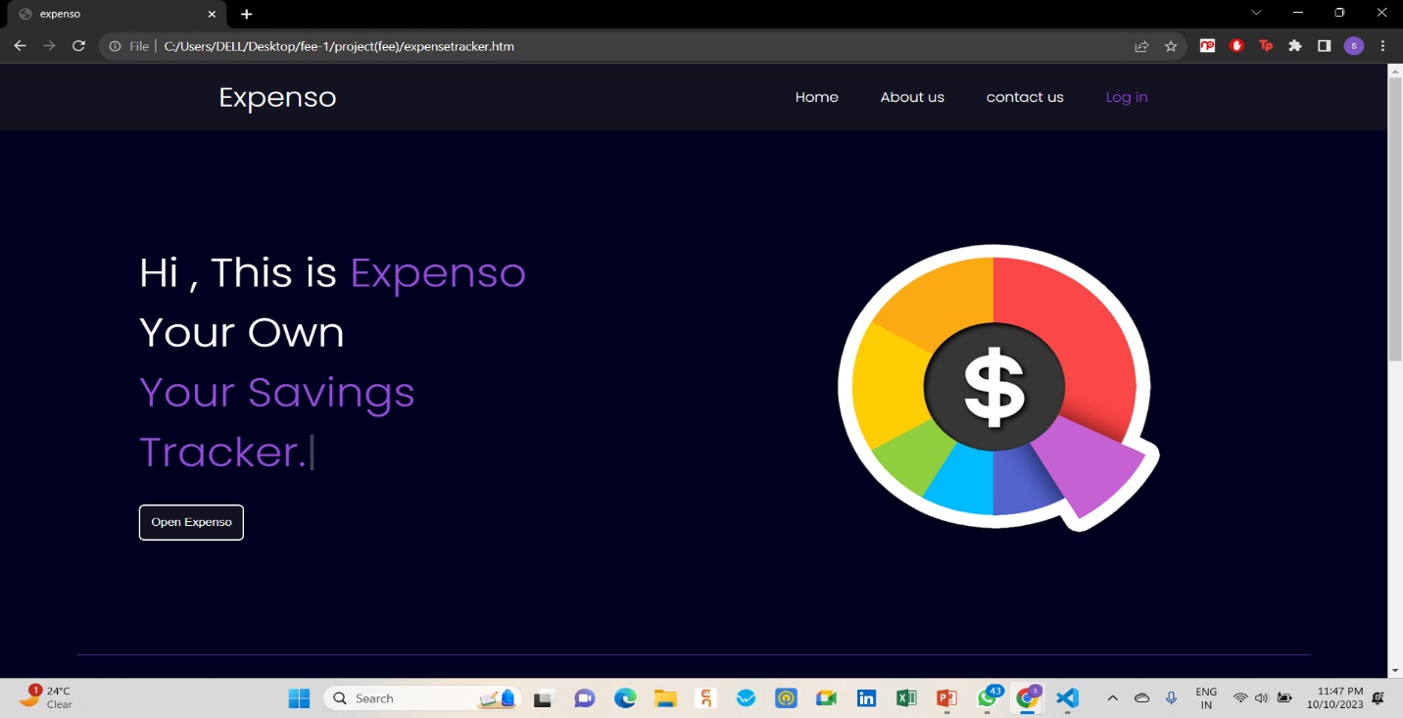
Project Highlights
Home page
animated text by java script

Slide 8
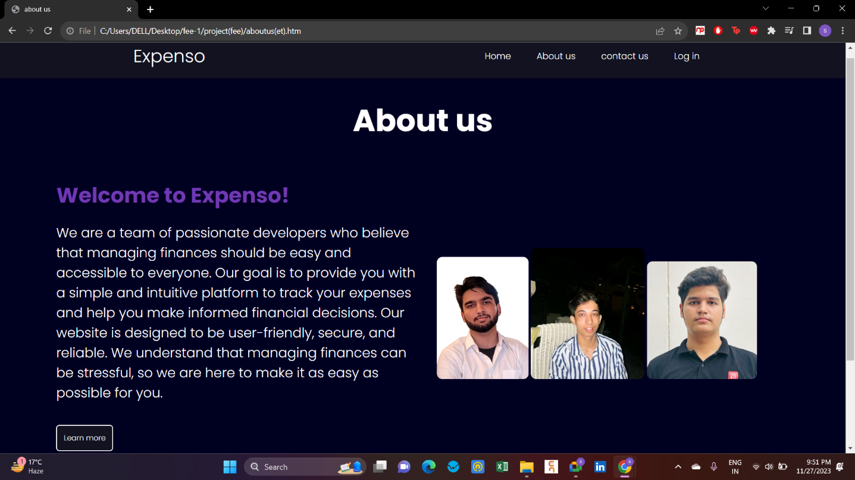
ABOUT US PAGE:

Slide 9
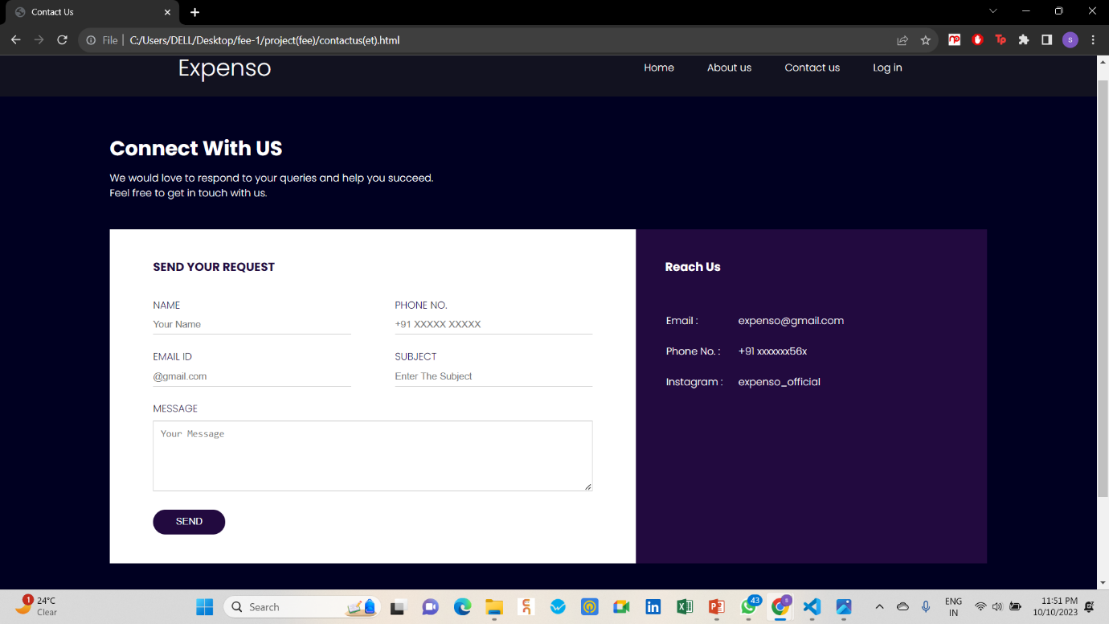
CONTACT US PAGE:

Slide 10
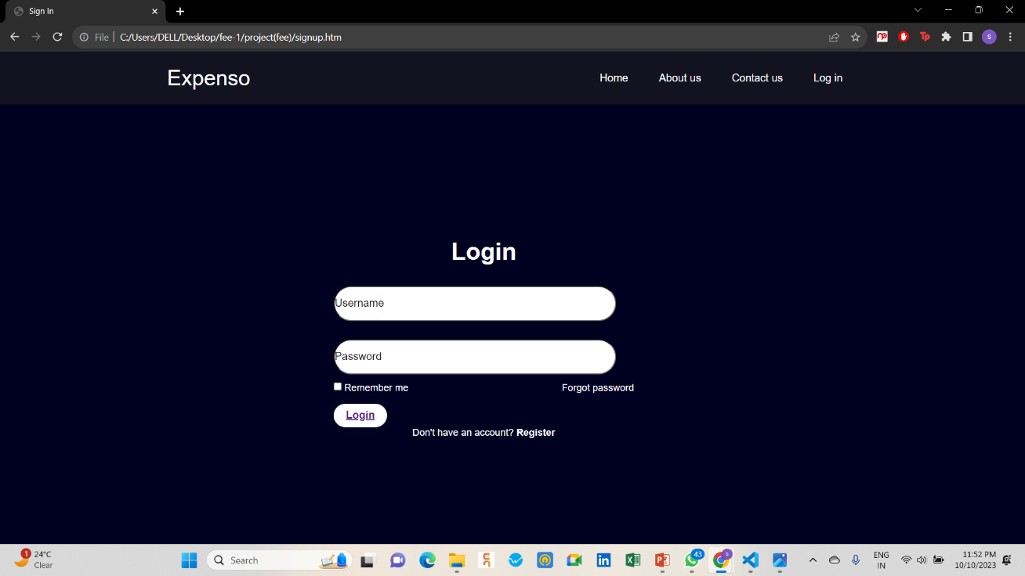
Login page:

Slide 11
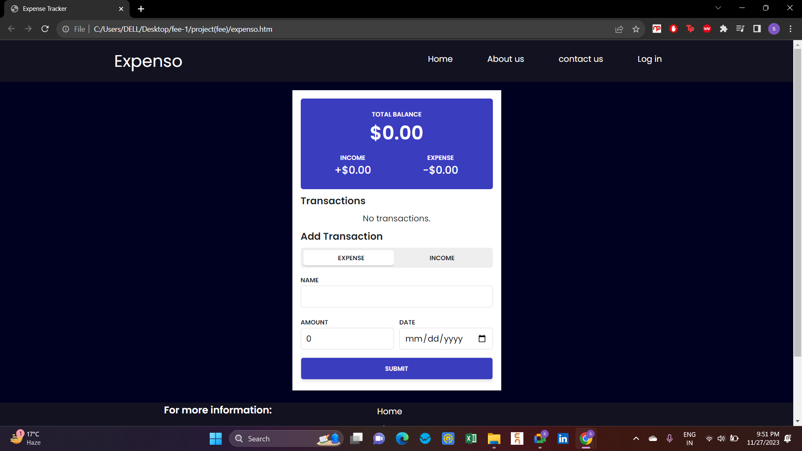
Expenso:

Slide 12
Bonus Feature(optional)
Simple and user-friendly website:
Our website is simple and user-friendly anyone can use it for their ease and give the ability to organize the financial terms for efficiently.
Pie chart view:
Our website has a feature which gives a pie chart view of the balance and expenditures on different entities.

Slide 13
Conclusion
Based on the features and benefits discussed, it is clear that our website on expense tracking is a valuable tool for individuals to effectively manage their finances. With its user-friendly interface, budget setting capabilities, and comprehensive expense analysis, your website provides users with the necessary tools to track their spending and make informed financial decisions. By utilizing our website, individuals can gain greater control over their expenses and work towards achieving their financial goals.

Slide 14
References/Links used
Reference codes:
www.geekforgeeks.com
www.w3schools.com
Fonts:
https://fonts.google.com/ (poppins)
Reference idea:
Notion

Slide 15


